Slide 1
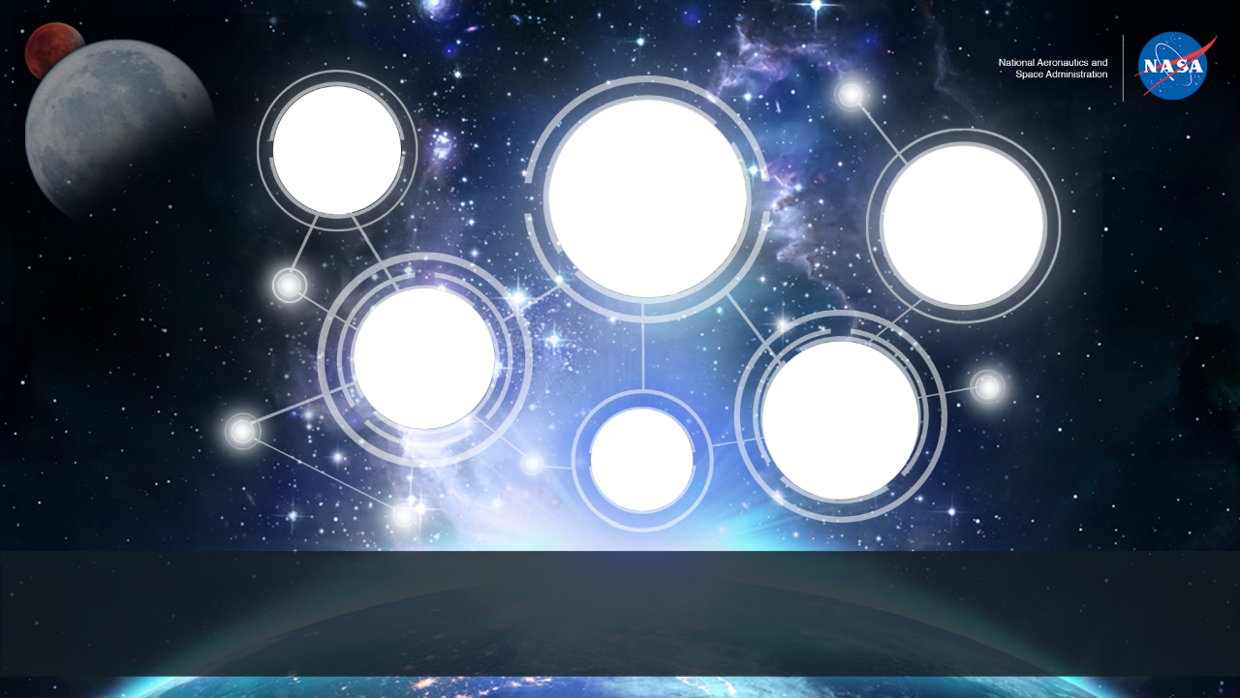
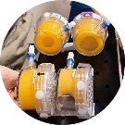
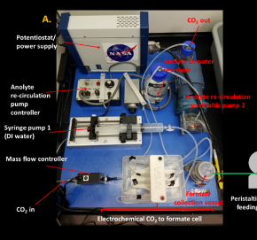
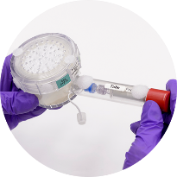
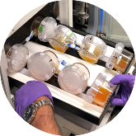
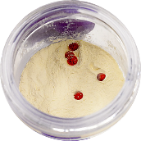
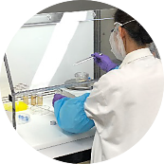
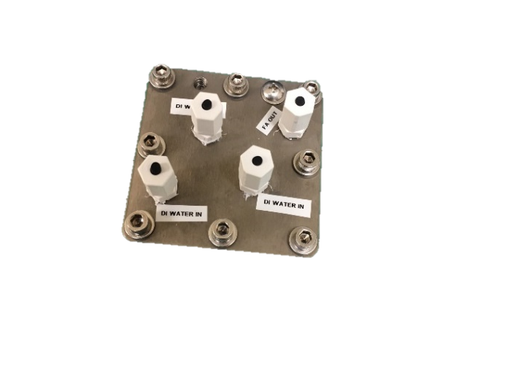
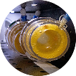
Space Technology Mission Directorate
Game Changing Development Program — Synthetic Biology (SynBio)
Frances Donovan| Synthetic Biology Project Monthly Status Report | 05.2021

Slide 2
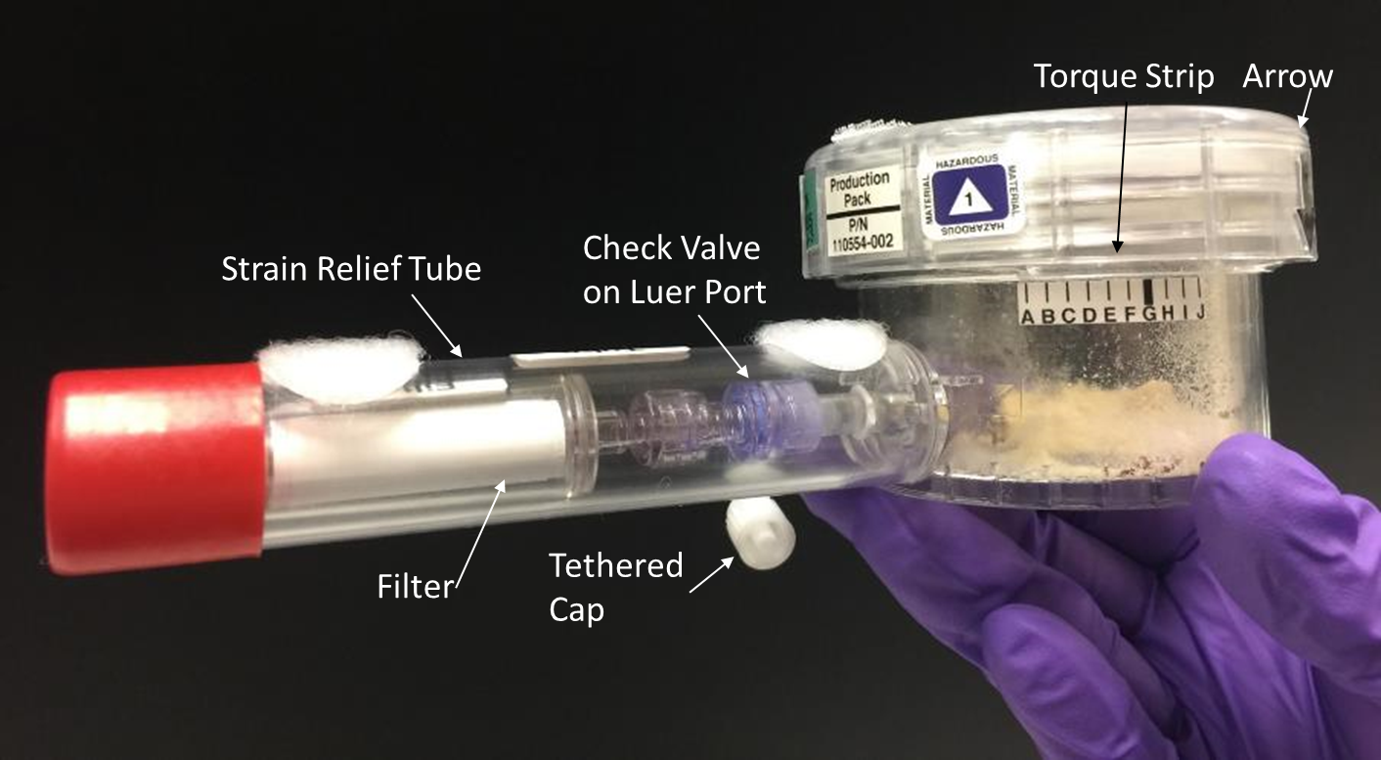
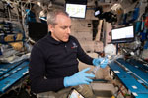
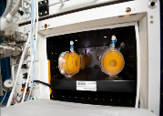
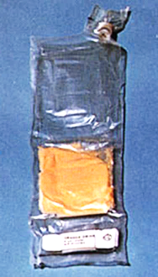
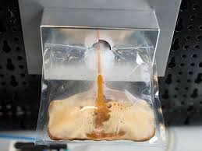

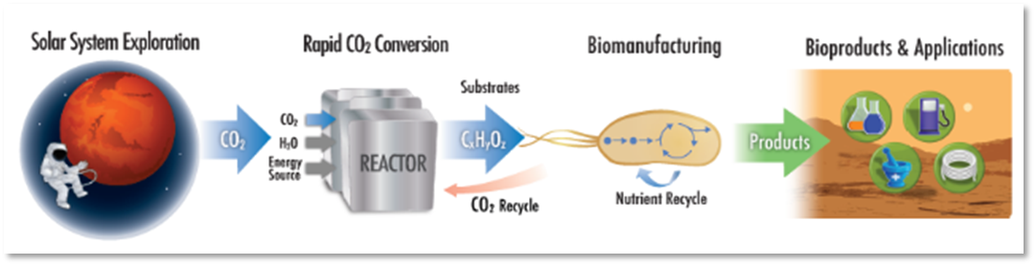
Project Overview
Technology Product Capability
Develop and demonstrate an on-demand nutrient production system for long-duration missions to mitigate demonstrated nutrient degradation in stored foods. Develop an evolvable platform for future surface missions – capable of producing other compounds (e.g., Medicines) requiring minimal resources. Perform an ISS time-course hydration, incubation, freezing and return for analysis over 5 year period.
Develop and demonstrate a prototype system that enables microbial manufacturing via abiotic CO₂ conversion to products that drive biomanufacturing for future long-duration missions.
Technical Capabilities
Reduced gravity compatible bioreactor development
Long-duration ambient storage of microorganisms
Methods for ensuring quality and safety of biomanufactured products
Development of ISRU based growth media
Space-relevant biomanufacturing system development
Space qualified organisms for biomanufacturing
Exploration & Science Applicability
Cross-cutting: Supports crew health, enhanced logistics, mission sustainability and risk reduction for extended duration habitation missions on the moon (Artemis) and Mars and space-based outposts.
BioNutrients -1 Flight Production Pack for on-orbit testing
Future Implementation Concept
Hybrid CO₂-Based Biomanufacturing Concept
Notes:
Provide an overview of the Project/Task
The slide content is intended to remain static unless significant changes are made to the Project
Pictures are encouraged, please provide new pictures as frequently as possible

Slide 3
Project Highlights/Accomplishments
Title | Type | Element | Description | New Image for EPO | Highlight Submitted
Systems Requirement Review | review | BioNutrients | Internal project milestone is complete. Science and Demonstration Requirements Document and Concept of Operations to be baselined week of 5/10/2021. | n/a | No
Phase 0/1 Safety Review | review | BioNutrients BN-2 mission | ISS Payload Safety Review Panel initial review of materials, chemicals, and operations proposed for BN-2 ISS mission. Panel had minimal concerns and provided feedback on expected safety verification tests and analysis. Status is approved with modifications of safety documents. | n/a | No
Notes:
Title - Provide a title for any noteworthy highlight/accomplishment
Type – Milestone, EPO, Test, etc..
Element – Portfolio Project: Specific Facet. Other: Map to Tech Assessment / Tech Element / Tasks
Provide your description.
New Image for EPO – Yes – Project Overview Slide or No.
Highlight Submitted – No, Yes, Will submit on XX/XX/XXXX.

Slide 4
SynBio
Project description: | Build organisms and bioreactor systems to demonstrate the value of emerging synthetic biology approaches to meet mission demands and support in situ resource utilization. | Current TRL: 3
Cost:
Schedule:
Y
Y
G
G
Y
G
G
G
G
Y
Monthly Trend
Monthly Trend
No cost issues at this time.
BioNutrients-2 production pack development and testing, and CO₂-based manufacturing bioreactor and genetic engineering of organisms delayed due to mandatory telework. Lab access has been regained on a limited basis for BioNutrients activities only (Nov 30), and impacts to the schedule of both tasks are ongoing.
Technical:
Programmatic:
G
G
G
G
G
Y
G
G
Y
G
Monthly Trend
Monthly Trend
No known technical challenges at this point, but schedule delays are impacting our progress.
PPBE package submitted with new proposed milestone schedule due to COVID impacts. Minimal increase in cost (10k) in FY22, modest increase in out years. CR reflecting this request is in work.
4
Notes:
Project Manager’s Assessment Chart
Provide a brief 1 or 2 line description of the Project and the Current TRL
Provide a monthly assessment for each area Cost, Schedule, Technical, and Programmatic (top right corner of each section). Do not change the colors for previously reported months
Red: Challenge or risk requires program support
Yellow: Challenge or risk can be managed within the project
Green: All project performance is satisfactory
Primarily focus on notable achievements or challenges your Project would like to highlight for awareness in that month
Portfolio Projects: Just speak to the ones that are yellow/red – speak to the specific element that has issues…

Slide 5
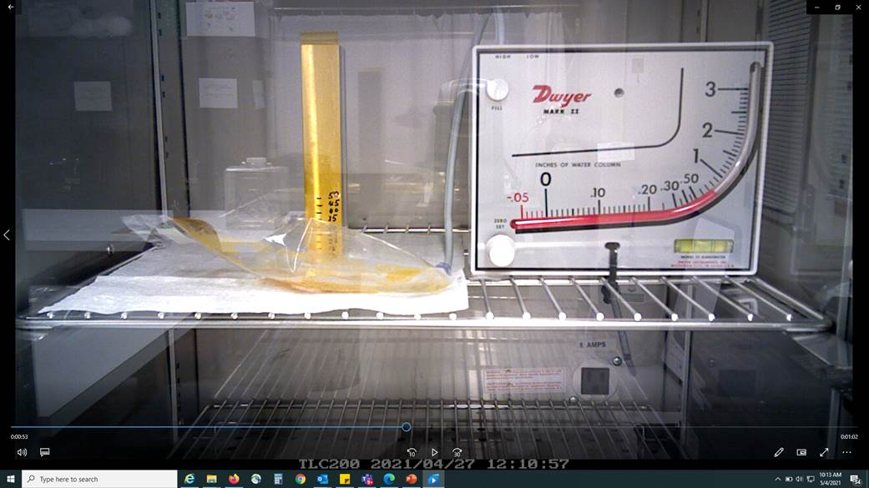
SynBio Additional Project Information
BioNutrients
BN-2 System Requirements Review (SRR) internal project milestone is complete. Science and Demonstration Requirements Document and Concept of Operations to be baselined week of 5/10/2021.
BN-2 phase 0/1 Safety Review passed 4/28/2021.
BN-2 Manifest Request Loader (MR Loader) data uploaded and ISS program review initiated on 4/29/2021.
BN-2 Investigation Summary Form submitted for ISS program review on 4/30/2021.
BN-2 Gen 1 bioreactor bag test with yeast engineered strains: Figure 1 biomass measurements indicate biocompatibility/growth and concomitant ethanol production within the bioreactor. This small amount of ethanol is expected and containment within the bioreactor is preferred by safety. Figure 2, Preliminary pressure testing of FEP bag indicates yeast growth will not create a pressure vessel. Preliminary testing indicates that the maximum design pressure of the bioreactor exceeds expected pressure values obtained during growth cycle. As planned, further testing and analysis will be used to verify safety requirements for this mission.
CO₂-Based Manufacturing System Development
Commercial support for test and fabrication as well as organism bio-engineering continues.
Purchase request in work to obtain a product-secreting capability in our chassis organism which will expand our capabilities and simplify product purification for secretion products.
Purchase request in work for a commercial vendor for proprietary cell lysis technologies to be tested for our system.
Evaluation of commercial products and activities in the CO₂ based manufacturing space has led to ESM analysis of various COTS options.
System requirements are being refined with systems engineering support, requirements document is being drafted.
Fig 1 BN-2 Biomass results for Y55, Boulardii, K.lactis-FOL tested in 5mil FEP bags. Ethanol concentration in the bag following 48hrs of incubation. K.lactis wild type strain tested prior to testing with engineered follistatin producing strain.
Project Management/General
PPBE phase 1 package submitted. Proposes new schedule based on return to facilities July 1. CR is in work.
TAPR and Design Review for BN-2 payload expected in June 14-25th time frame.
CUBES Annual Review to be held May 5-6th.
CO₂ conversion Centennial Challenge status: Phase 2 judging is commencing for three teams.
Summer internships: two students have been selected for summer internships
Fig 2 BN-2 FEP bioreactor growing yeast does not fully expand bag material and generates pressure far below the maximum design pressure. Preliminary results.

Slide 6
Project Plan - Milestone Status
Milestone Title (Mirror Project Plan) | Baseline Date | Planned Date | Variance Explanation
Status of milestones due since last report
C4-CO2 ​Space Compatible System Design Review​ | 04/15/21 | TBD, targeting Dec 2021 | Delay due to lack of lab access, target date is for 6 months after expected return to lab. CR will be submitted in combination with PPBE per direction at PM forum.
Status of milestones due in the next 60 days
C3-BN Generation 1 Flight Pack Design Review – will now combine with TAPR, targeting mid-June, new baseline set to July 15. | July 15 | June 15-25 time frame | SME reviewers identified and their availability for this review confirmed. TAPR-ToR document is in preparation. Final date for review is dependent on panel availability but review will be virtual and we have reasonable confidence we can meet our target time frame.
Notes:
The milestones shown on this chart should reflect the milestones in the Project plan

Slide 7
Project Risks, Issues/Concerns
Project Risks
Risk ID | Affinity | Likelihood/ Consequence (if applicable) | Description/Status | Trend | Proposed Mitigations
Risk 1 | S | 5/2 | If delays in lab access result in incomplete testing and data acquisition, the Design Review for BioNutrients-2 will not occur on Jan 19th as planned. | realized | Delay the Design Review until the required testing can be completed. CR was approved to move review to be no later than July 15.
Issues/Concerns
Issue Title | Description/Status | Proposed Mitigations
COVID-19 schedule impacts | The progression of several tasks on the project has been delayed due to lack of access to laboratory facilities. Upcoming controlled milestone, a design review for the BioNutrients-2 next generation bioreactor will not occur per plan and will likely have >30 day slip. | Delay the Design Review until the required testing can be completed. For other tasks the level of optimization and development will be impacted if schedule relief is unavailable.
Notes:
Project risks (include only upwardly trending yellow and red risks) and proposed mitigations
Project Risks are those that are formally recognized – if applicable (can use the format you use for reporting to your Center)
Issues/Concerns
Issues/Concerns are a heads-up, not quite to the level of an actual Project Risks

Slide 8
Education/Public Outreach
EPO Involvement
EPO Calendar Outlook (High Priorities):
30 Day Look-Ahead
60 Day Look-Ahead
Paper submitted to 50th International Conference on Environmental Systems - ICES 202, July 12-14, team will attend virtually.
Notes:
Summary of the EPO activities (papers, conferences, outreach events) participated in over the last 30 days and the forward outlook 30-60 days

Slide 9


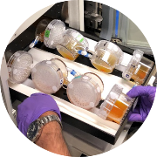
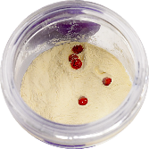
Space Synthetic Biology
View of BioNutrients-1 production packs during ISS crew operations. Packs were removed from incubator for mid-course agitation.
CO₂-Based Manufacturing project prototype that demonstrated the production of formic acid from CO₂ and water, while also producing oxygen.
Ground testing of BioNutrients-1 production packs in SABL flight incubator (ground unit) to verify temperature, fit and no leakage.
View of open BioNutrients-1 production pack during loading. Dried edible media (powder) and yeast pellets (red) are visible.
State-of-the-Art CO₂ electrochemical system that converts CO₂ and water to formic acid without electrolytes. The formic acid serves as an media for microbial production systems.
Loading BioNutrients-1 production packs with media and organisms under sterile conditions. The pack lid and sterile water filter are attached during this assembly.

